Slide 1

Smart Vision System for Night-Time Image Enhancement and Object Detection
Major Project Presentation
ECE Department

Slide 2
TEAM MEMBERS
NAME | REGD NO.
ABHIJEET KUMAR MAHATO | 2301020630
ARYAN KUMAR SINGH | 2301020636
ANAND KUMAR | 2301020634
VISHAL PANDEY | 2401030067

Slide 3
Problem Statement
Poor visibility: Night-time CCTV images often suffer from low brightness and poor contrast.
Difficult object identification: Important objects such as people and vehicles may become difficult to identify in dark scenes.
Reduced detection performance: Low-quality night-time frames can make automated object detection more challenging.
Surveillance limitations: Reduced visibility can affect the effectiveness of monitoring in offices, banks, campuses, parking areas, and residential societies.
Need for enhancement: A system is required to improve the visibility of night-time frames before performing object detection.

Slide 4
Objectives
Enhance night-time images and videos to improve brightness and visibility.
Improve local contrast using CLAHE after brightness enhancement.
Detect objects such as persons, cars, motorcycles, and bicycles using YOLO11n.
Process video frames automatically for night-time surveillance.
Generate a clear surveillance output with detected objects and bounding boxes.
Evaluate the effect of enhancement on object detection performance.

Slide 5
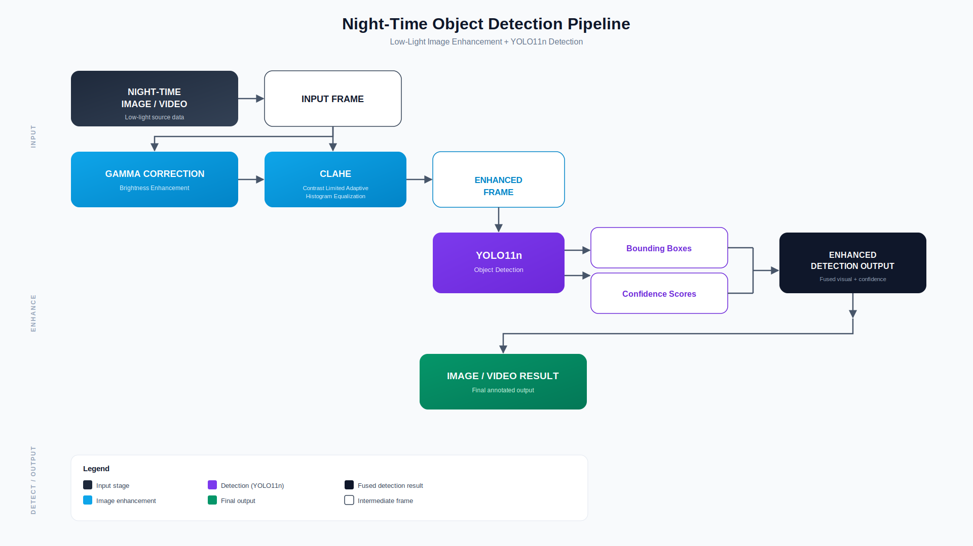
System Workflow

Slide 6
Methodology
1. Input Acquisition
Capture or load a night-time image/video.
Video is processed frame-by-frame using OpenCV.
2. Night-Time Image Enhancement
Gamma Correction is applied to improve brightness.
CLAHE (Contrast Limited Adaptive Histogram Equalization) is applied to improve local contrast and reveal details in dark regions.
3. Object Detection
The enhanced frame is passed to the YOLO11n pretrained model.
YOLO identifies objects and generates bounding boxes and confidence scores.
A confidence threshold of 0.40 is used in the current implementation.
4. Output Generation
Detected objects are displayed on the enhanced frame.
For video, processed frames are combined and saved as the final night detection video.

Slide 7
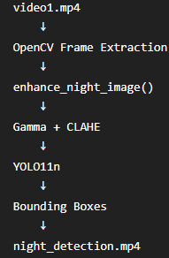
Implementation
Developed using Python and OpenCV.
Gamma Correction + CLAHE implemented as the night-time enhancement module.
YOLO11n used for object detection.
Supports both image and video processing.
Video frames are processed individually and detection results are displayed using bounding boxes.
The processed detection video is saved as an output file.
Current prototype uses a 0.40 confidence threshold.
Software used : Python, OpenCV, Ultralytics YOLO11n, NumPy, VS Code

Slide 8
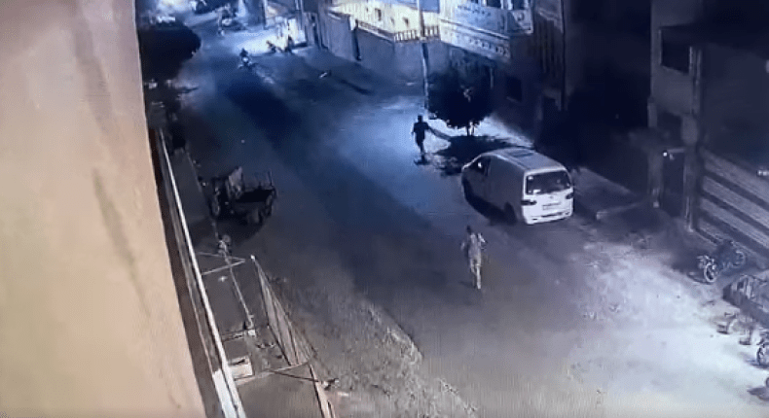
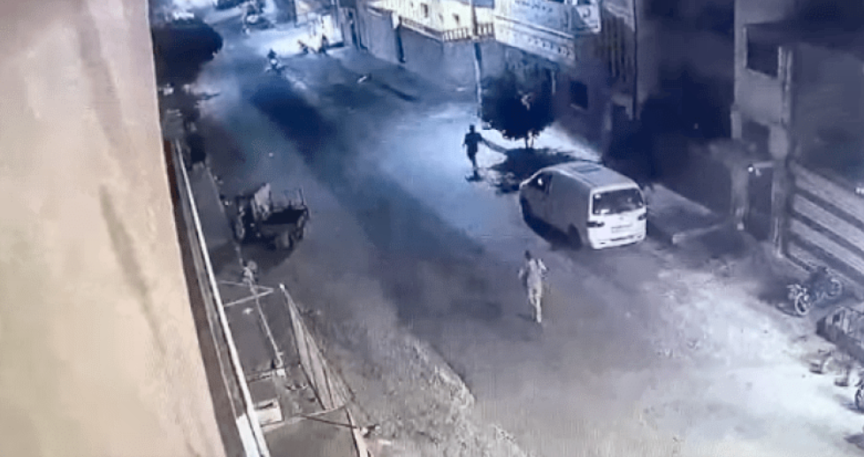
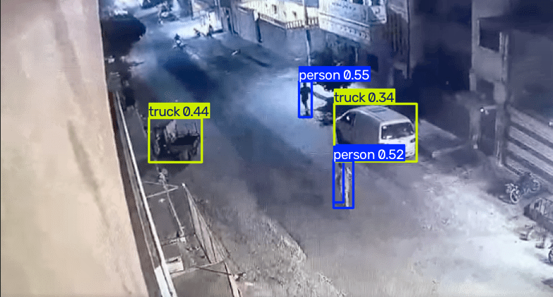
Results
Original Image :
Enhanced image :
Image detection:

Slide 9
Future Scope
Real-Time Surveillance – Deploy the system for live CCTV video processing.
Face Recognition – Identify authorized and unauthorized persons.
Number Plate Recognition – Automatically detect and read vehicle number plates.
Smart Alerts – Generate alerts when specific objects or activities are detected.
Cloud Integration – Store enhanced videos and detection results on cloud platforms.
Edge Deployment – Run the system directly on edge devices for faster processing and reduced latency.
Advanced Enhancement – Explore deep-learning-based low-light enhancement for better results in extremely dark scenes.

Slide 11
Thank You
Questions & Discussion

